Slide 1

Machine Learning for Engineers: Support Vector Machine (SVM)
Mina Farmanbar
Associate Professor, University of Stavanger
for engineers

Slide 2
Support Vector Machine (SVM)
It is one of the best "out of the box" supervised classification techniques that classifies cases by finding a separator.
It can be employed for both classification and regression purposes.
SVMs are more commonly used in classification problems and as such, this is what we will focus on in this post.

Slide 3
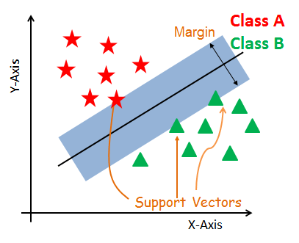
SVM
SVMs are based on the idea of finding a hyperplane that best divides a dataset into different classes. Here we have binary classification.
https://bit.ly/45Mg1jN

Slide 4
Support Vectors
Support vectors are the data points nearest to the hyperplane.
The points of a dataset that, if removed, would alter the position of the dividing hyperplane.
Because of this, they can be considered as the critical elements of a dataset.
https://bit.ly/45Mg1jN

Slide 5
What is a hyperplane?
As a simple example, for a classification task with only two features, you can think of a hyperplane as a line (decision boundary) that linearly separates and classifies a set of data.
https://bit.ly/45Mg1jN

Slide 6
What is a hyperplane?
Intuitively, the further from the hyperplane our data points are, the more confident we are that they have been correctly classified.
https://bit.ly/45Mg1jN

Slide 7
What is a hyperplane?
We therefore want our data points to be as far away from the hyperplane as possible, while still being on the correct side of it.
So, when new testing data is added, whatever side of the hyperplane it lands will decide the class that we assign to it.
https://bit.ly/45Mg1jN

Slide 8
What is a Margin?
It is the distance between the hyperplane and the observations closest to the hyperplane (support vectors).
In SVM large margin is considered a good margin.
https://bit.ly/45Mg1jN

Slide 9
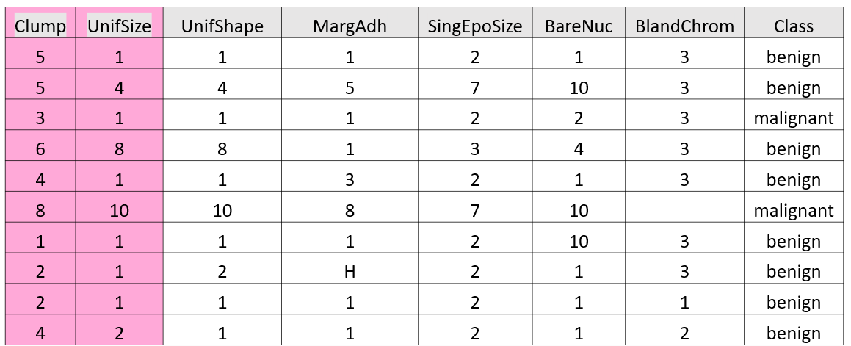
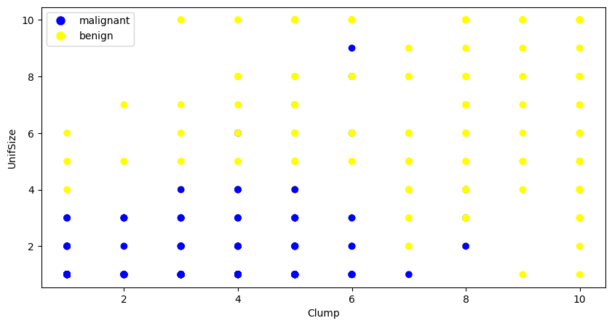
Consider the following Example:

Slide 10
SVM

Slide 11
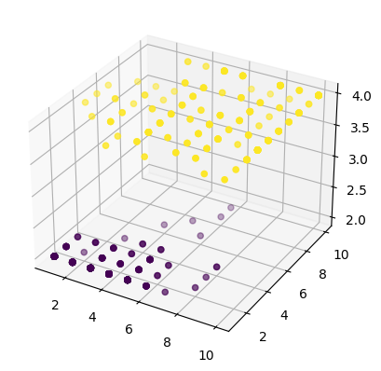
Transforming to 3-dimensional Space
Plane
This plane can be used to classify new or unknown cases. Therefore, the SVM algorithm outputs an optimal hyperplane that categorizes new examples.

Slide 12
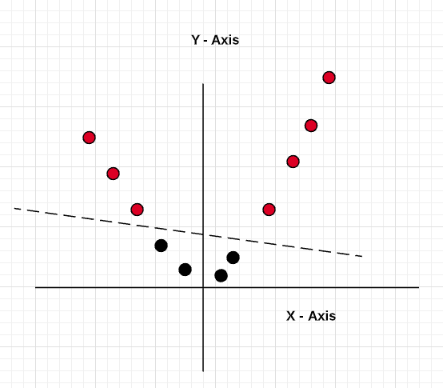
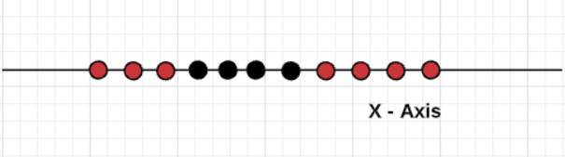
Data Transformation
$$∅\left(x\right)=[x, x^{2}]$$
Not linearly separable
Linearly separable

Slide 13
SVM
Basically, mapping data into a higher-dimensional space is called, kernelling.
The mathematical function used for the transformation is known as the kernel function.
Linear
Polynomial
Radial Basis Function, or RBF
Sigmoid

Slide 14
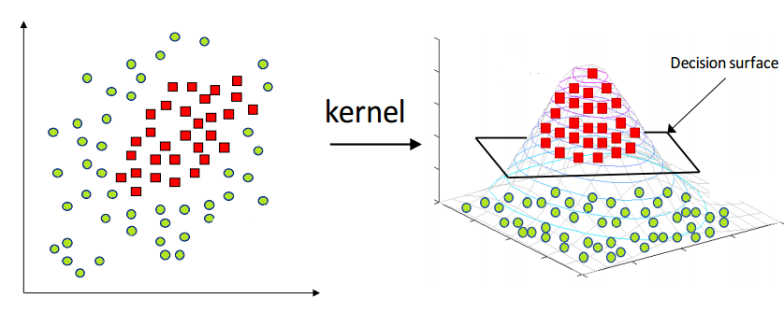
SVM
https://nguyenkm.com/wp-content/uploads/2023/04/1mcwnu5kxot6bul7jeiafqq.png

Slide 15
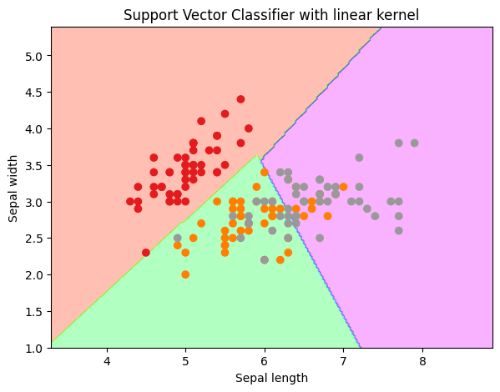
Linear Kernel
Linear Kernel is used when the data is Linearly separable using a single Line.

Slide 16
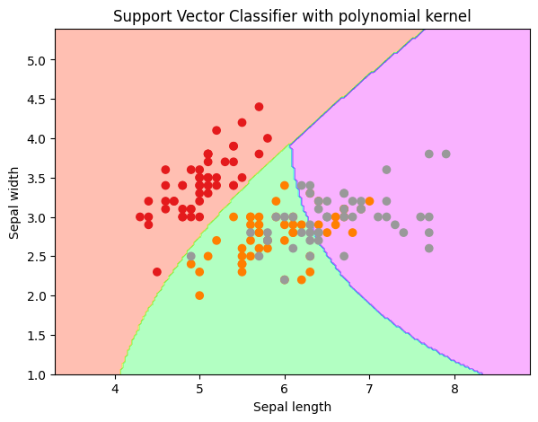
Polynomial Kernel
It allows the classifier to fit the hyperplane by mapping the input features into polynomials of a specified degree.

Slide 17
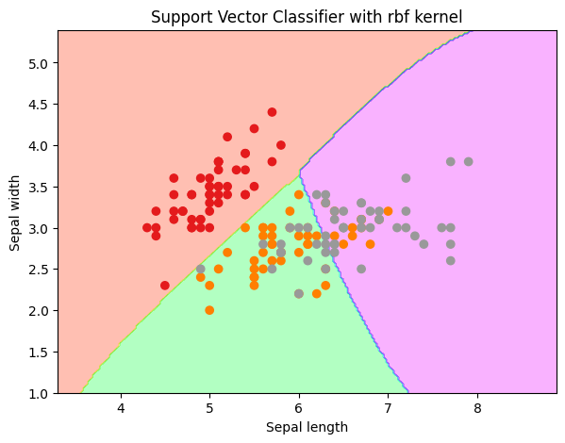
Radial Basis Function, or RBF
It creates non-linear combinations of our features to lift samples onto a higher-dimensional feature space where we can use a linear decision boundary to separate classes.

Slide 18
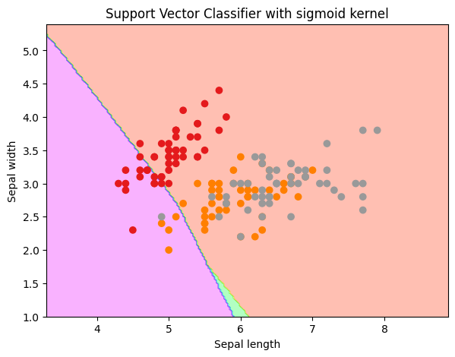
Sigmoid Kernel
The sigmoid kernel can model non-linear and sigmoidal relationships between the data points

Slide 19
SVM
As there's no easy way of knowing which function performs best with any given dataset, we usually choose different functions in turn and compare the results.

Slide 20
How do we find the right hyperplane?
SVM works by first mapping data to a high dimensional feature space so that data points can be categorized, even when the data are not otherwise linearly separable.
Then, a separator is estimated for the data.
The data should be transformed in such a way that a separator could be drawn as a hyperplane.

Slide 21
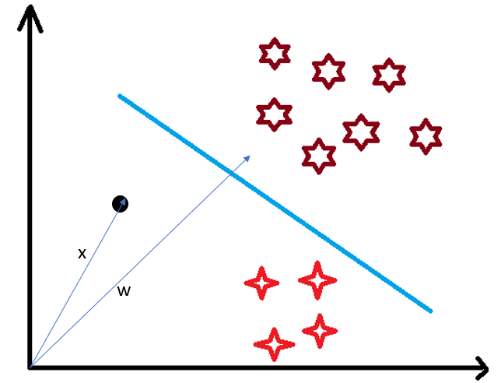
Use of Dot Product in SVM
Consider a random point X and we want to know whether it lies on the right side of the plane or the left side of the plane (positive or negative).
https://editor.analyticsvidhya.com/uploads/947387.png

Slide 22
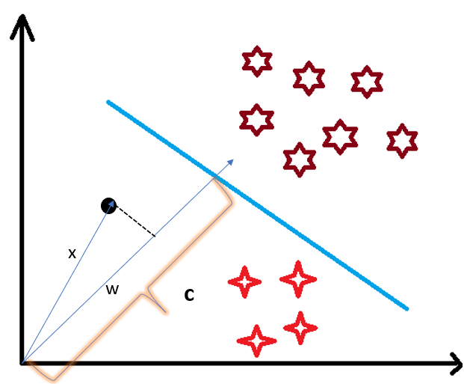
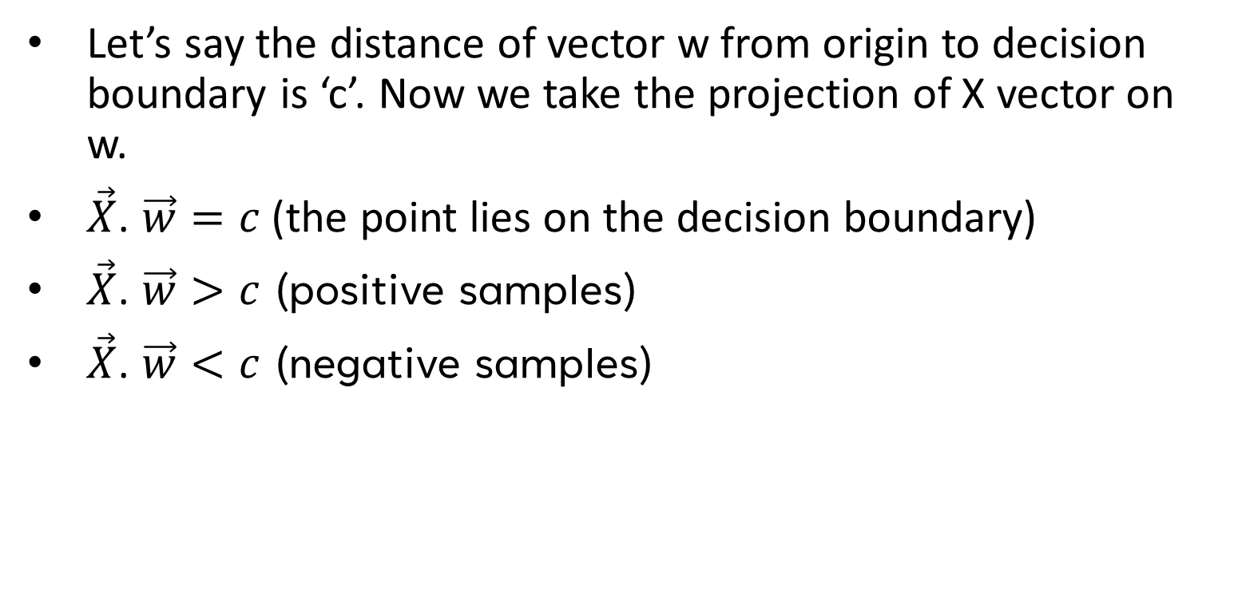
SVM
Let’s say the distance of vector w from origin to decision boundary is ‘c’. Now we take the projection of X vector on w.
$\vec{X}$. $\vec{w}=c$ (the point lies on the decision boundary)
$\vec{X}$. $\vec{w}>c$ (positive samples)
$\vec{X}$. $\vec{w}<c$ (negative samples)
https://editor.analyticsvidhya.com/uploads/947387.png

Slide 23
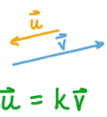
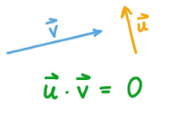
SVM
You must be having this doubt that why did we take this perpendicular vector w to the hyperplane?
what we want is the distance of vector X from the decision boundary and there can be infinite points on the boundary to measure the distance from.
So, we simply take perpendicular and use it as a reference and then take projections of all the other data points on this perpendicular vector and then compare the distance.
Parallel Vectors
Perpendicular Vectors

Slide 24
Advantages of SVM
They are accurate in high-dimensional spaces.
They use a subset of training points in the decision function called, support vectors, so it's also memory efficient.

Slide 25
Disadvantages of SVM
The algorithm is prone for over-fitting if the number of features is much greater than the number of samples.
SVMs are not very efficient computationally if your dataset is very big, such as when you have more than 1,000 rows

Slide 26
Summary
SVM is good for image analysis tasks, such as image classification and handwritten digit recognition and text mining tasks.
SVM can also be used for other types of machine learning problems, such as regression, outlier detection and clustering.

Slide 27
Thank you
Mina Farmanbar
mina.farmanbar@uis.no

